Slide 1
Revision Tut
19 / 11 / 25 (21 days to freedom)
Vijay
(Too lazy perfectionist to pick any other theme)

Slide 2
Topics to be covered
Normal forms
SQL queries
Ordering
ACID
Key types
ER model
Types
Constraints
General doubts (To an extent)
End Sem paper
This Tut’s slides were made from the book and “online sources”

Slide 3
(Lec 11 – 12)
Normal forms
Let’s start from the basics. PS: The project phase was based on this btw.
What is the point?
Good relational database design. Normalization is described as a "filtering" or "purification" process to make the design have successively better quality
Reduces the chance of update, delete or insertion anomalies.
Build on top of the previous one.
Normal Form | Constraint Focus | Key Concepts
First Normal Form (1NF) | Multivalued/Composite Attributes | Atomic Values
Second Normal Form (2NF) | Partial Dependencies on Key | Full Functional Dependency
Third Normal Form (3NF) | Transitive Dependencies | Nontransitive Dependency
Boyce-Codd Normal Form (BCNF) | Any Determinant that is Not a Superkey | Strict Superkey Constraint

Slide 4
1NF
1NF is currently considered part of the formal definition of a relation in the basic (flat) relational model.
The central constraint is that the domain of an attribute must include only atomic (simple, indivisible) values, and the value of any attribute in a tuple must be a single value from that domain. This explicitly disallows multivalued attributes, composite attributes, and nested relations.
Goal: Creating relations which qualify as a relation in the basic relational model
Method: For a relation that violates 1NF (e.g., contains a multivalued attribute A and primary key K), the generally best method is to remove the multivalued attribute A and place it in a separate relation, , along with the primary key K of the original relation.

Slide 5
Prime Attributes
Any attribute that is part of at least one candidate key.
Ex: A table `Student Course` with attributes {Student_ID, Course_ID, Grade}.
If the combination {Student_ID, Course_ID} is the only candidate key (since it uniquely identifies a grade), then:
Prime Attributes: Student_ID and Course_ID.
Non-Prime Attribute: Grade

Slide 6
1NF to 2NF
2NF deals with partial dependency, which occurs if a nonprime attribute is determined by a proper subset of a candidate key. If the primary key consists of a single attribute, the relation is automatically in 2NF (provided it is in 1NF)
Goal: To remove the update anomalies caused by partial functional dependencies
Method:
Identify any nonprime attributes A that are partially dependent on a subset X of the primary key K (i.e., X→A holds, but X is smaller than K).
Decompose the original relation R into two new relations:
R₁: Includes X and all attributes fully dependent on X (which should include all attributes determined by the full key K).
R₂: Includes the partial key X and the attributes A that were partially dependent on X

Slide 7
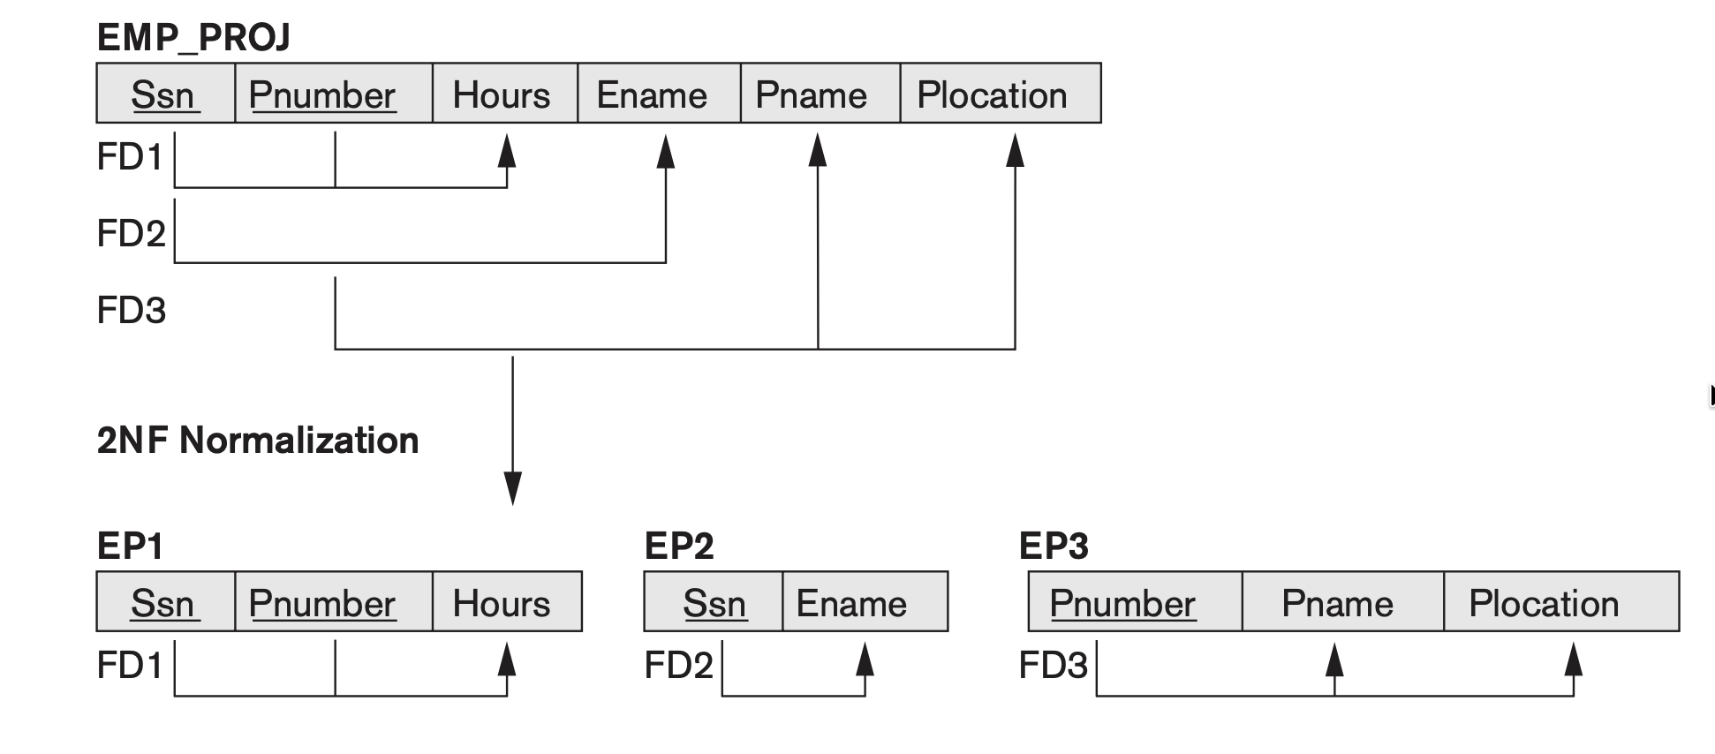
1NF to 2NF (Book Pg 482)

Slide 8
2NF to 3NF
3NF satisfies Transitive dependency, where a functional dependency X→Y holds, and there is a set of attributes Z (that is neither a candidate key nor a subset of any key) such that X→Z and Z→Y both hold.
Goal: To remove the update anomalies caused by transitive functional dependencies
Method:
Identify any transitive dependencies where a non key attribute Z determines another non key attribute A (Z→A), and the primary key determines Z (K→Z).
Decomposition: Decompose the original relation R into two new relations:
R₁: Includes K and Z (and any non key attributes fully dependent on K but not transitively on Z).
R₂: Includes Z and A (and any attributes determined by Z).

Slide 9
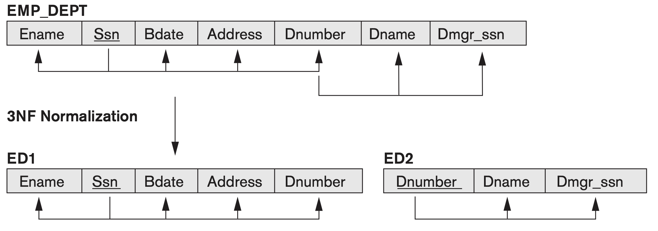
2NF to 3NF

Slide 10
3NF
Third Normal Form (3NF) if, whenever a nontrivial functional dependency X→A holds in R, either:
(a) X is a superkey of R; or
(b) A is a prime attribute of R

Slide 11
3NF vs BCNF
BCNF removes clause (b) from the general definition of 3NF, which allowed functional dependencies where the right-hand side was a prime attribute even if the left-hand side was not a superkey. Relations that satisfy 3NF but not BCNF still suffer from redundancy, necessitating the stricter BCNF.
Method:
If a relation Q is not in BCNF, it means there is a nontrivial FD X→Y where X is not a superkey of Q.
Decomposition: The relation Q is replaced by two new relation schemas: (Q−Y) and (X∪Y). This procedure is applied iteratively until all resulting relations are in BCNF, and it is designed to achieve the non additive join property

Slide 12
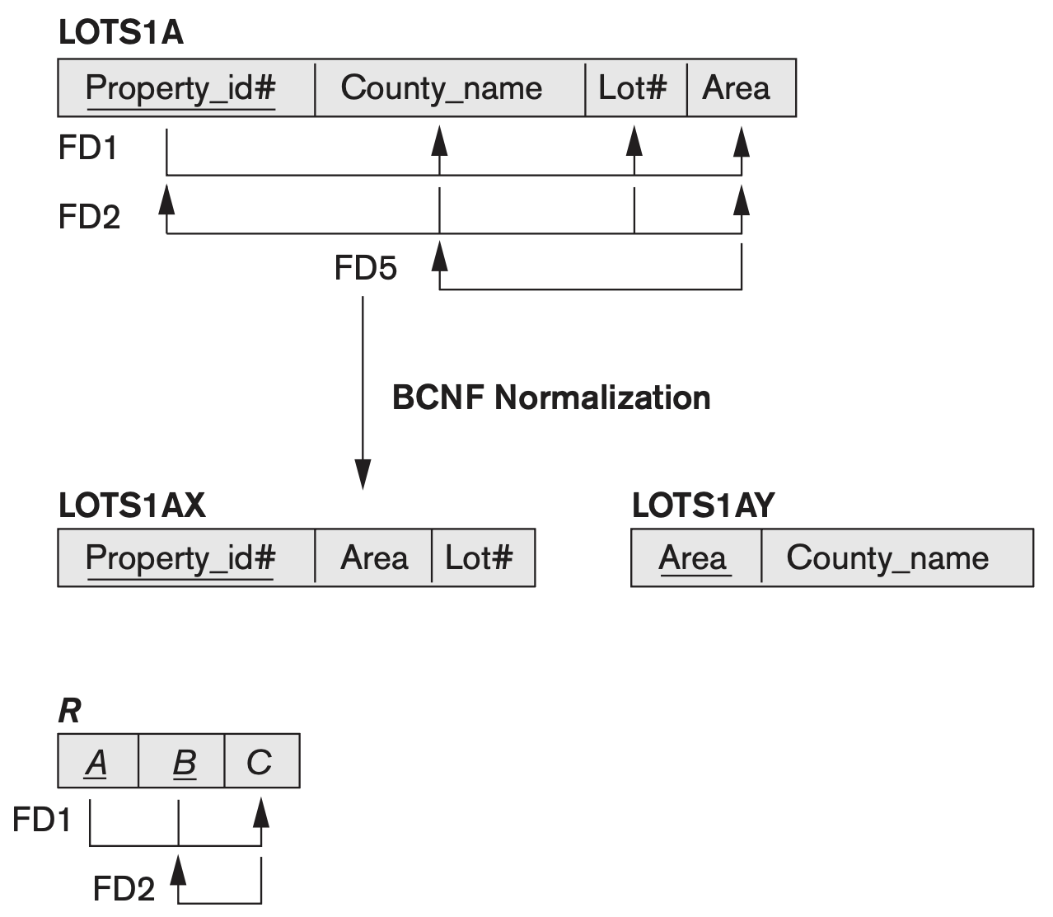
3NF vs BCNF
Prime attributes:
"Does the attribute at the start of the arrow (the tail) uniquely identify the entire row?"
If YES: It is in BCNF.
If NO: It violates BCNF and must be split.

Slide 13
SQL queries (only the harder ones) (Lec 9-10
WHERE
LIKE
% (percent sign): replaces an arbitrary number of zero or more characters
_ (underscore): replaces a single character
Ex: WHERE Address LIKE ‘%Houston,TX%’
BETWEEN
(Salary BETWEEN 30000 AND 40000) = ((Salary >= 30000) AND (Salary <= 40000))
Syntactic sugar
ORDER BY
Default sort direction is ascending (lowest value first, or alphabetically A-Z). You can specify the direction using the keywords ASC (ascending) or DESC (descending)
Left to right
ORDER BY D.Dname DESC, E.Lname ASC, E.Fname ASC
Group BY
Allows you to apply aggregate functions (like COUNT, AVG, SUM, MAX, and MIN) to subgroups of tuples in a relation
Ex: SELECT Dno, COUNT (*), AVG (Salary) FROM EMPLOYEE GROUP BY Dno;

Slide 14
SQL queries (only the harder ones) (Lec 9-10
HAVING
HAVING clause can appear only in conjunction with a GROUP BY clause
Used to write queries based on the
Ex: HAVING COUNT (*) > 2
BULK LOADING
CREATE TABLE customers_ny_backup AS SELECT customer_id, first_name, last_name, email FROM customers WHERE state = 'NY';

Slide 15
SQL queries (only the harder ones) (Lec 9-10
NESTED queries
Retrieve the name of each employee who has a dependent with the same first name and the same sex as the employee
SELECT E.Fname, E.Lname FROM EMPLOYEE AS E WHERE EXISTS ( SELECT * FROM DEPENDENT AS D WHERE E.Ssn = D.Essn AND E.Sex = D.Sex AND E.Fname = D.Dependent_name);

Slide 16
Ordering of SQL select
SELECT <attribute and function list> (Mandatory)
FROM <table list> (Mandatory)
[ WHERE <condition> ] (Optional)
[ GROUP BY <grouping attribute(s)> ] (Optional)
[ HAVING <group condition> ] (Optional)
[ ORDER BY <attribute list> ] (Optional)

Slide 17
ACID. (Lec 3)
Atomicity: A transaction is an atomic unit of processing;
Should either be performed in its entirety or not performed at all.
Consistency preservation: A transaction should be consistency preserving
It is completely executed from beginning to end without interference from other transactions.
Isolation: A transaction should appear as though it is being executed in isolation from other transactions, even though many transactions are executing concurrently.
Durability: The changes applied to the database by a committed transaction must persist in the database. These changes must not be lost because of any failure.

Slide 18
Key Types (Lec 6)
Super Key
Any unique set of columns / attributes that can uniquely identify rows
Key or candidate key
Uniqueness: No two tuples (rows) in the table can have the same key value.
Minimality: No subset of that key can uniquely identify the tuple.
Primary Key
This a selected candidate key

Slide 19


Random seal picture to get attention back

Slide 20
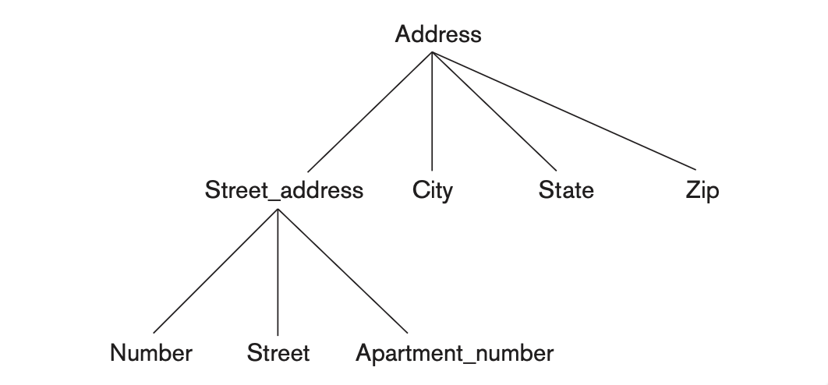
ER model (Lec 3 and 4)
2 main components
Entities
Attributes
Relations
😱
Entities are things or objects in the real world with an independent existence.
An entity may be an object with a physical existence (for example, a particular person, car, house, or employee) or it may be an object with a conceptual existence (for instance, a company, a job, or a university course).
Attributes are of different types
Simple
Composite
Multivalued (Not allowed)
Derived (On the fly calculated. Ex. Age)

Slide 21
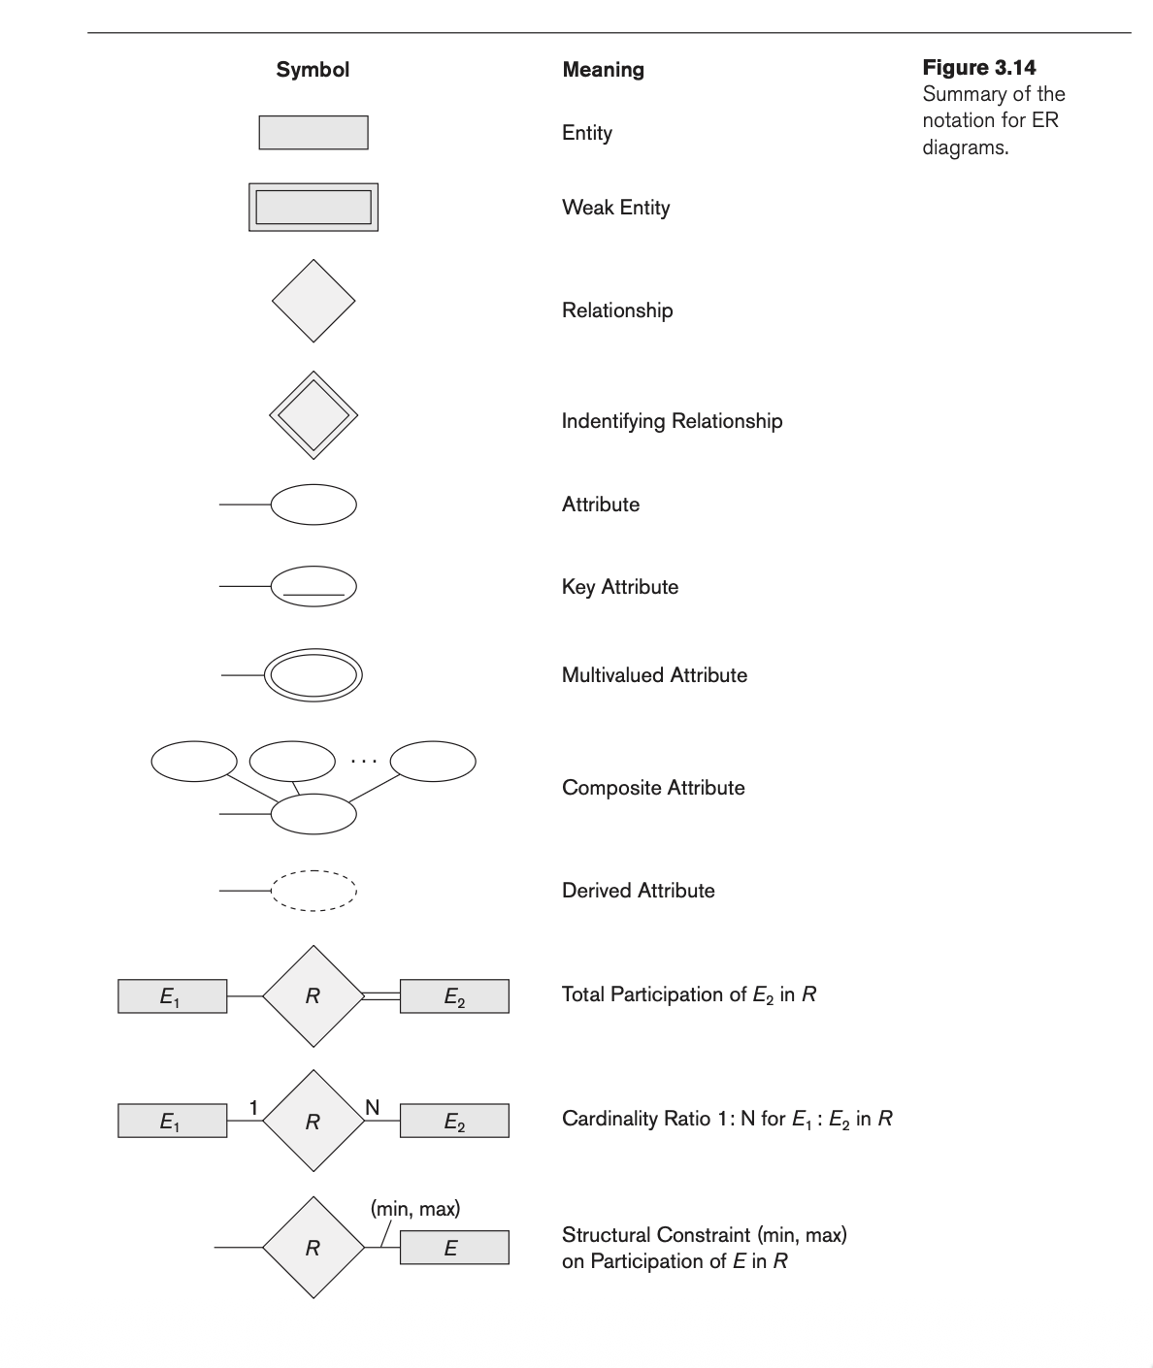
ER model (Lec 3 and 4 + Book pg 115)

Slide 22
Types of relations (Lec 5)
Recursive
Degree based: Number of participating entities; Ex: Binary, ternary
Participation based
Min max based
1:1
1:N
M:N
Add diagrams

Slide 23
Constraints (Chapter 5, Pg 157 + Lec 5-6)
Inherent (Implicit) Constraints
Defined by the data model itself (e.g., a relation is a set, so no duplicate tuples are allowed).
Schema-Based (Explicit) Constraints (Specified in DDL)
Domain Constraints: Attribute values must be atomic and belong to a defined data type (e.g., Integer, Date).
Key Constraints: Rules for uniqueness to identify tuples (Superkey, Candidate Key, Primary Key).
Entity Integrity: The Primary Key of a relation cannot be NULL.
Referential Integrity: A Foreign Key must either match an existing Primary Key in the referenced relation or be NULL.
Constraints on NULLs: Specifies if attributes are permitted to be NULL (e.g., NOT NULL).
Application-Based (Semantic) Constraints
Business rules difficult to express in the schema, enforced by application logic (e.g., "Max 56 work hours/week").
Other Constraint Categories
Transition Constraints: Restrictions on valid state changes (e.g., "Salary can only increase").
Data Dependencies: Functional and multivalued dependencies used for normalization and design quality.
Existence Dependency Constraint

Slide 24
SQL constraints (Lec 8)
Used to set constraints on the table when its being created or altered
2 main methods
With the attribute
Ex: PRIMARY KEY
Using the CHECK clause
CREATE DOMAIN D_NUM AS INTEGER CHECK (D_NUM > 0 AND D_NUM < 21);
CREATE TABLE DEPARTMENT (
Dname VARCHAR(15) NOT NULL,
Dnumber INT NOT NULL,
Mgr_ssn CHAR(9) NOT NULL,
Mgr_start_date DATE,
PRIMARY KEY (Dnumber),
UNIQUE (Dname),
FOREIGN KEY (Mgr_ssn) REFERENCES EMPLOYEE(Ssn),
CHECK (Dnumber > 0 AND Dnumber < 21)
);

Slide 25
Possible violations for each operation
Refer textbook / Slides (Lec 7-8)
Use notebook LM

Slide 26
Joins
Refer book / Slides (Lec 10)

Slide 27

Thank you for listening
Please feel free to ask questions on moodle or course group
Pro tip: Pls don’t write the make up quiz (Will be hard)
VA

